Slide 1
Continuous Integration and Delivery for Databases
Jimmy Bogard
@jbogard
github.com/jbogard
jimmybogard.com
Chief Architect, Headspring

Slide 2
Be kind to your DBAs

Slide 3
Your company prefers their data to your code

Slide 4
CI/CD (Easy Mode)

Slide 5




😎

Slide 6
Applications are (ideally) stateless

Slide 7
Applications are easy to create/destroy

Slide 8
Databases are by nature stateful

Slide 9
Data is much, much easier to screw up

Slide 10
Data screwups are much harder to recover from

Slide 11
You won’t get fired for killing an application

Slide 12
You *will* get fired for killing a database

Slide 13
We need to be able to change our database over time

Slide 14
We want the same rigor applied to our applications as our databse

Slide 15
We don’t want to be paralyzed by fear

Slide 16
We need continuous integration and delivery for databases

Slide 17
We don’t want a human manually running queries in production

Slide 18
We need a way to safely automate changes to our database

Slide 19
Two main approaches: Desired State Config (DSC) Migrations

Slide 20

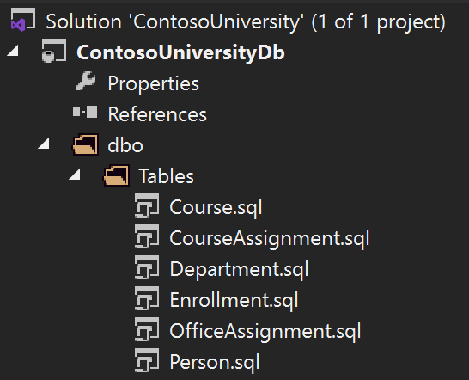
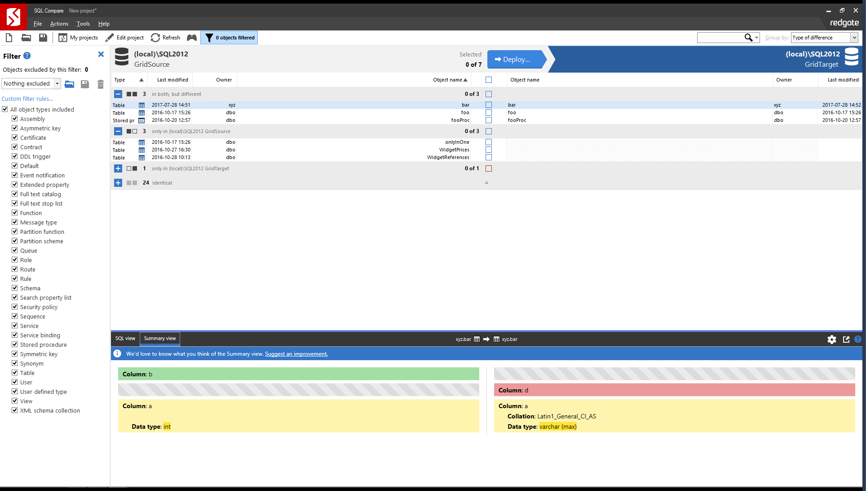
DSC Tooling/Products

Slide 21
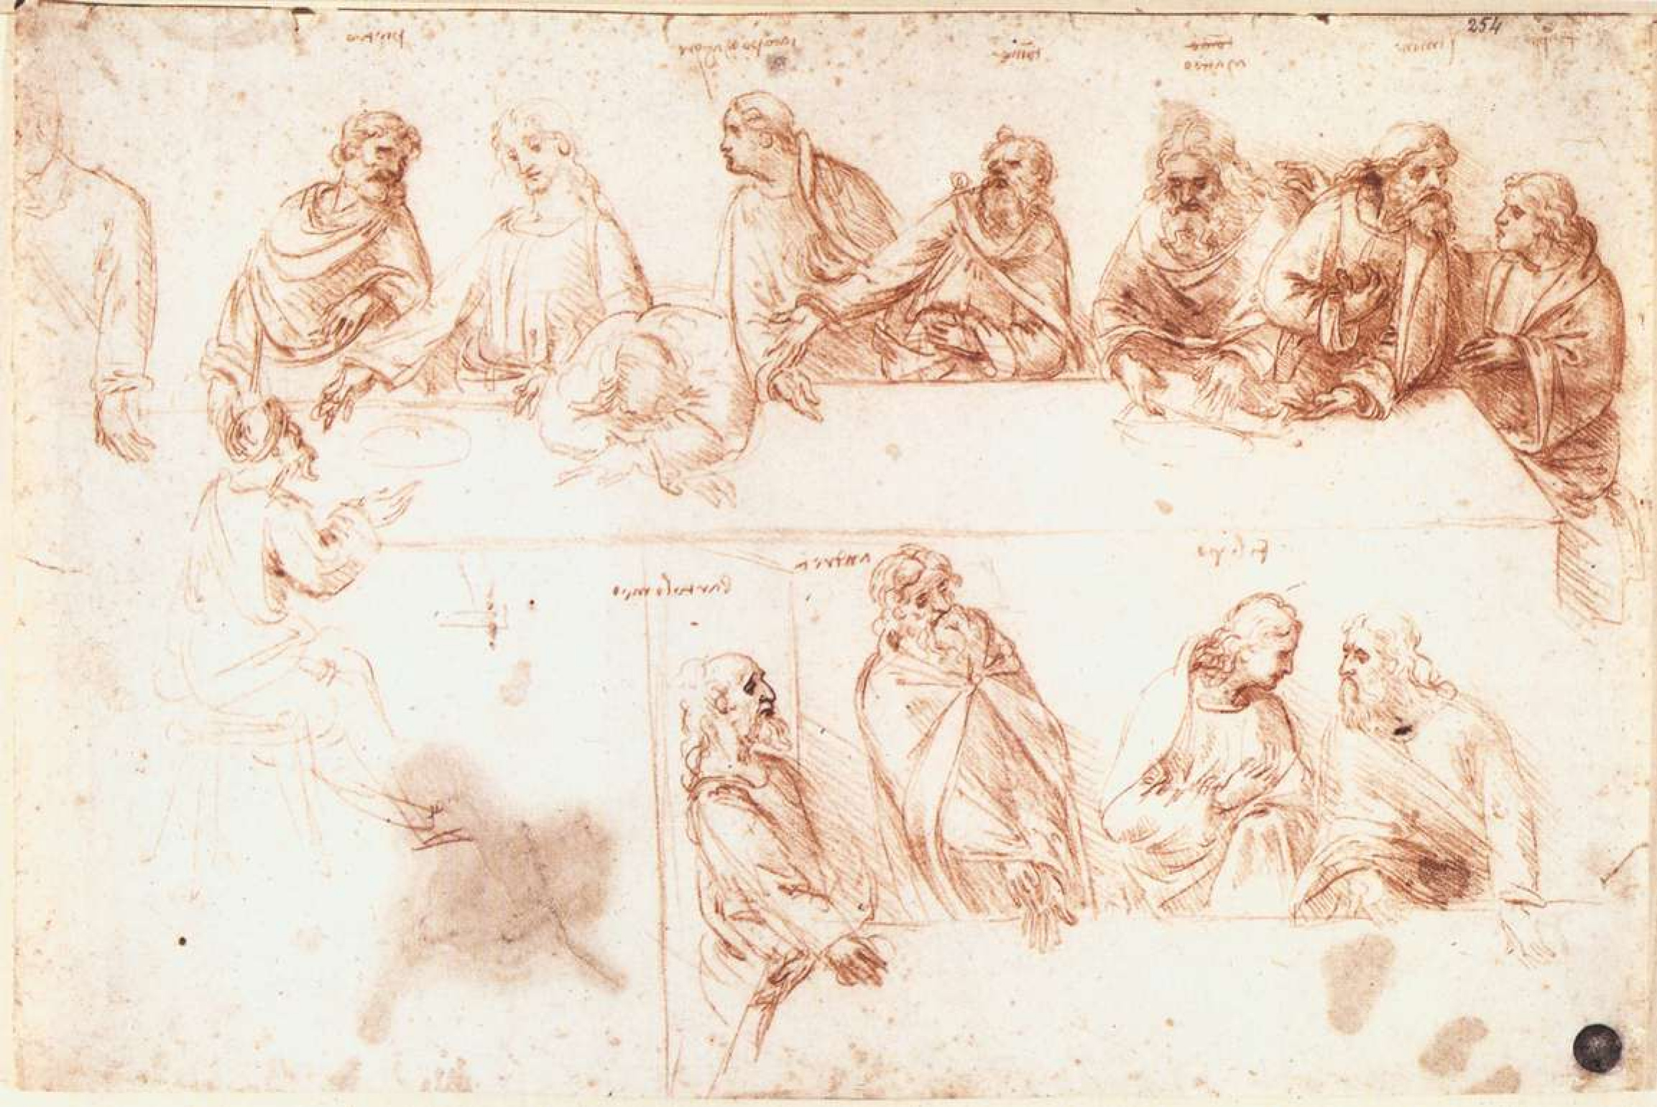
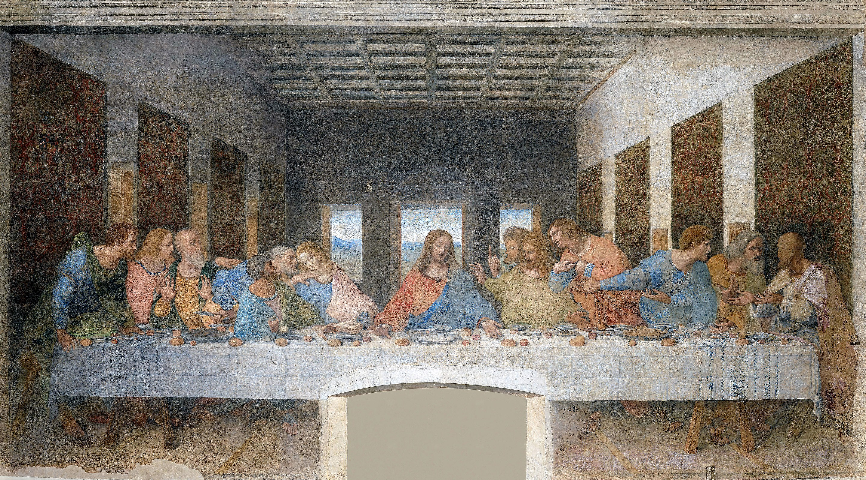
Desired State Configuration

Slide 22
These are well engineered, powerful tools

Slide 23
But they introduce the possibility of failure

Slide 24
Failure requires human intervention

Slide 25



Slide 26
Tools aren’t perfect for automating change detection and deployment

Slide 27
The further the drift, the harder the automation

Slide 28
Enter: database migrations

Slide 29
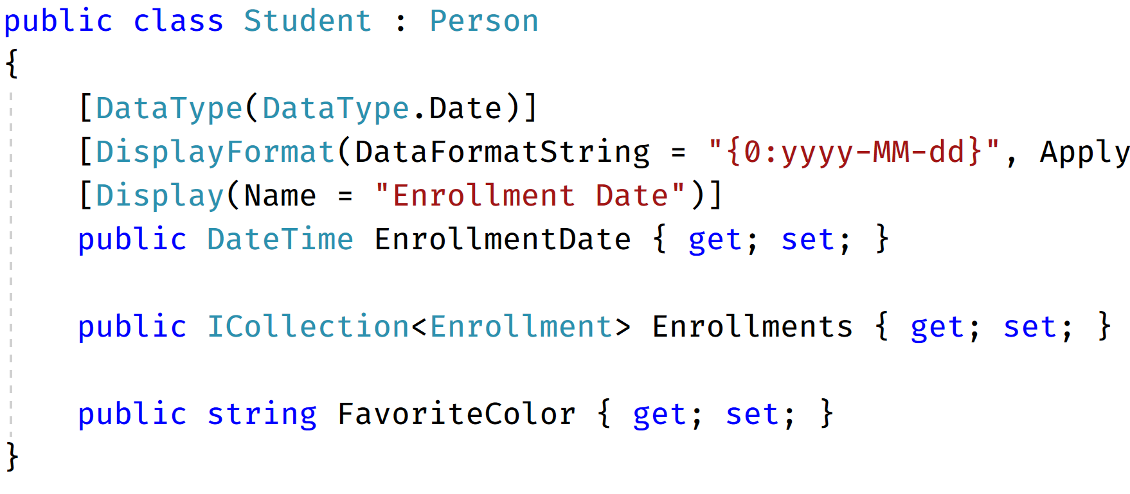
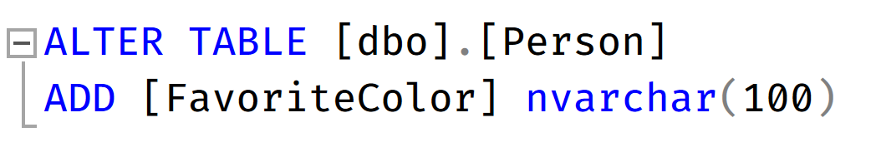
Code + Data changes together

Slide 30
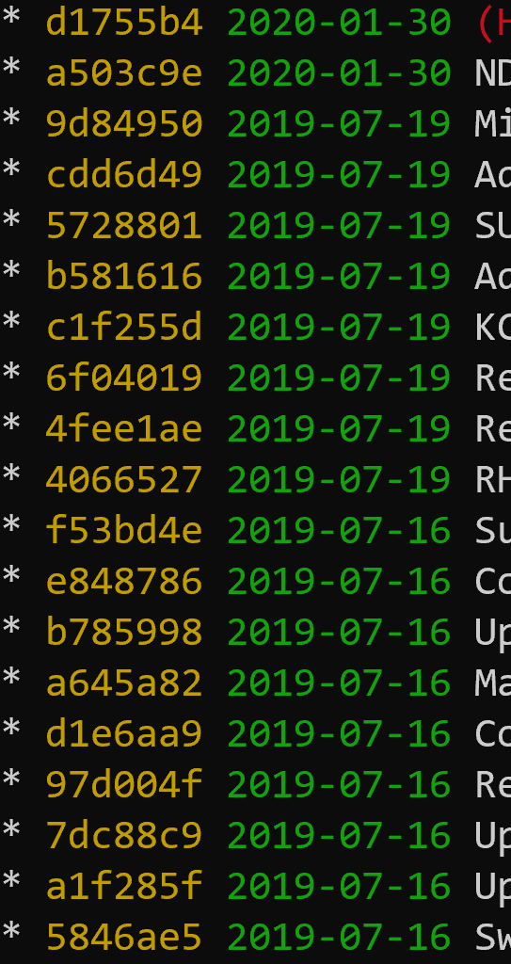
Capture changes over time with code
V2
V1

Slide 31
1. Way to capture changes 2. Way to apply changes 3. Way to remember changes

Slide 32
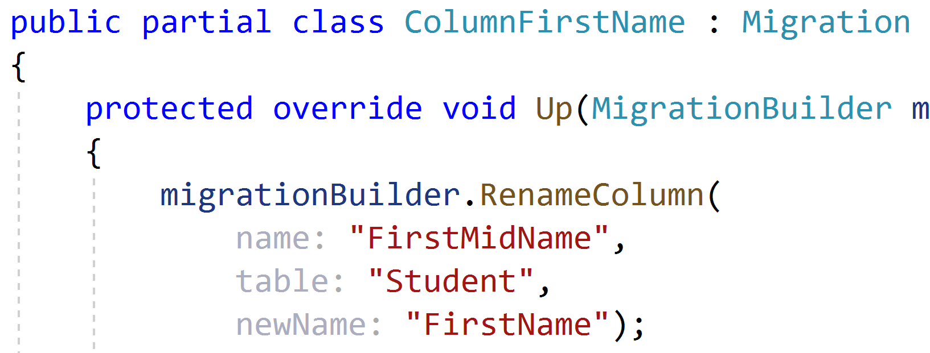
EF Migrations

Slide 33
Not very DBA-friendly

Slide 34
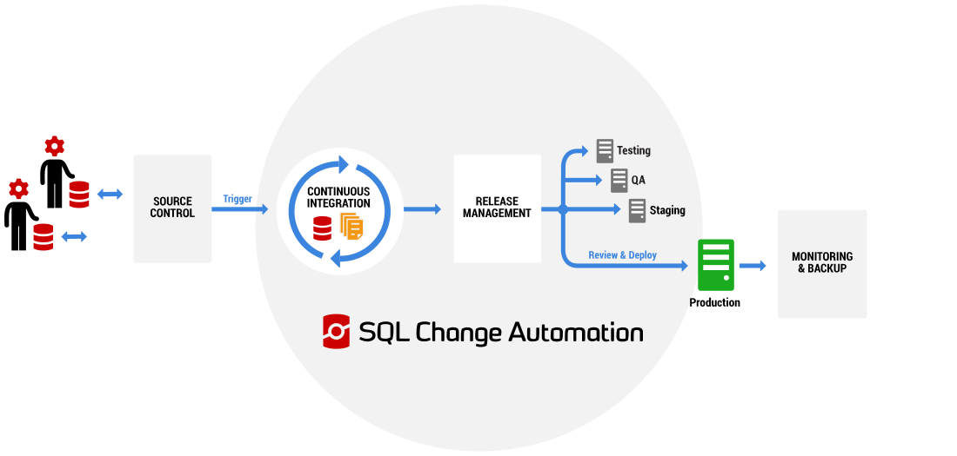
RedGate SQL Change Automation

Slide 35
Not very wallet-friendly
$3495/developer

Slide 36
RoundhousE Migrations
SQL-centric
Lots of DB support
.NET Core-based
https://github.com/chucknorris/roundhouse

Slide 37
😎

Slide 38
Every environment with its own logical database

Slide 39
😎
Dev
Test

Slide 40
Demo

Slide 41
😎
Test

Slide 42
Demo

Slide 43
Dev
😎
Prod

Slide 44
Demo

Slide 45
Migrations at scale

Slide 46
Idempotency?

Slide 47
Transactional DML!

Slide 48
Check if exists

Slide 49
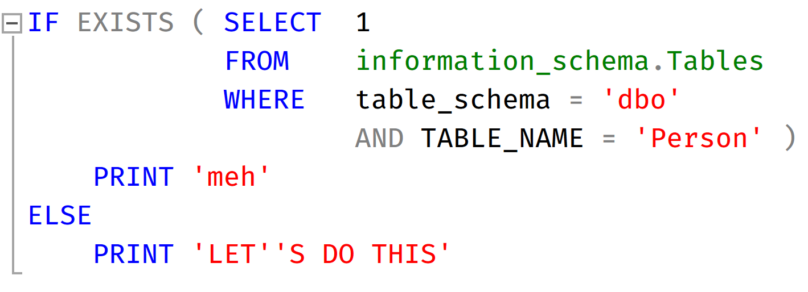
Example: Table

Slide 50
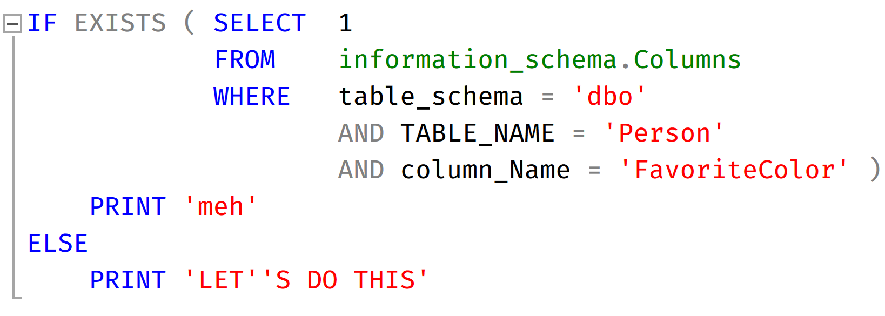
Example: Column

Slide 51
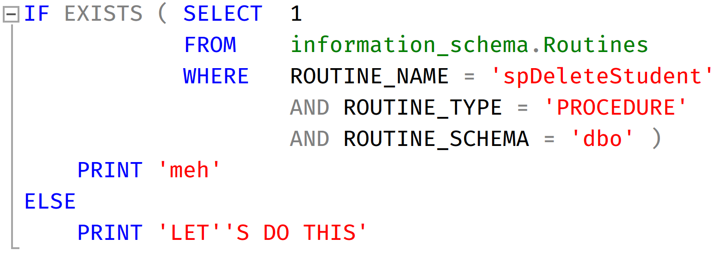
Example: Stored Procedure

Slide 52
Two categories of changes: 1) Stateful 2) Stateless

Slide 53
Stateful changes include schema AND data migrations

Slide 54
Stateless Changes

Slide 55
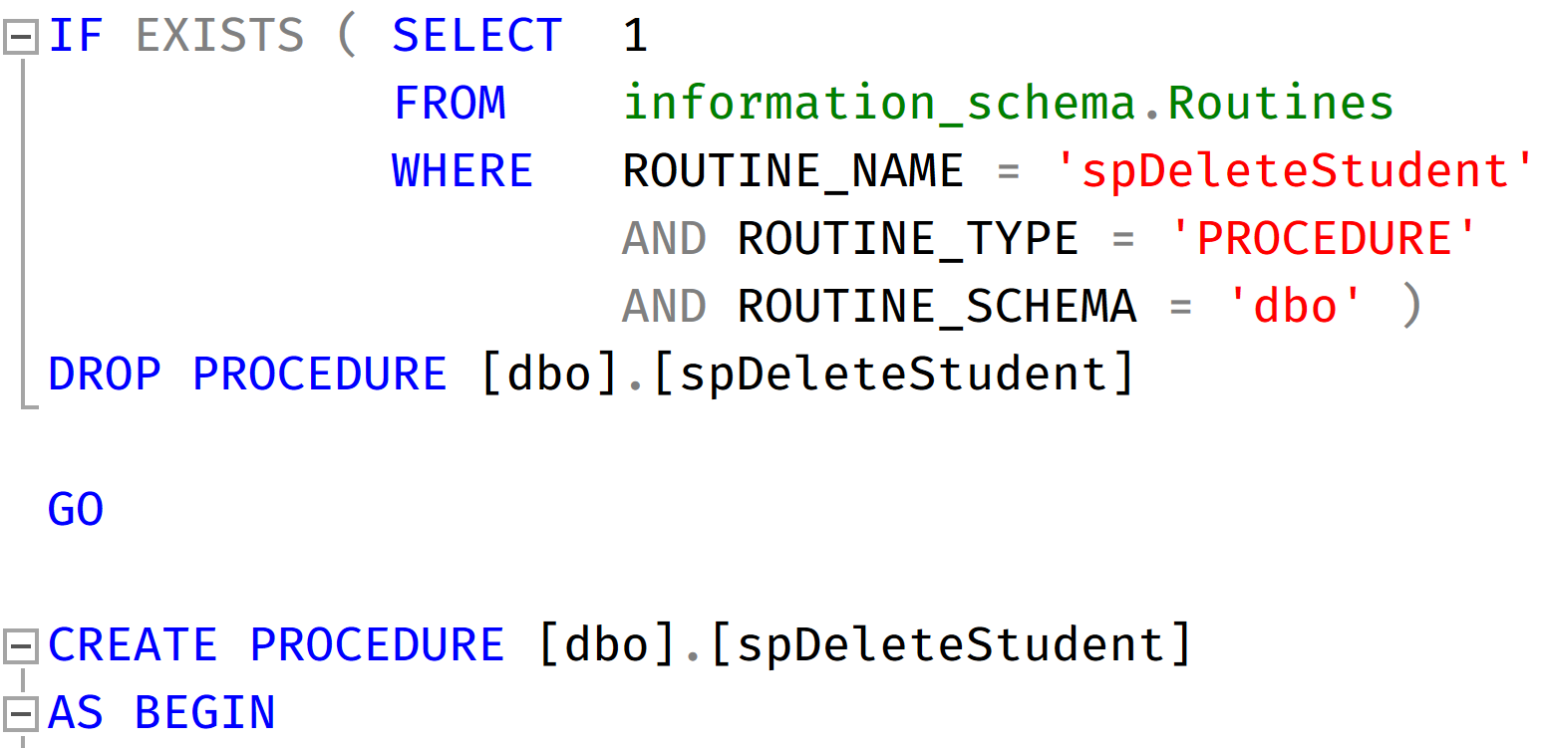
Drop/Create

Slide 56
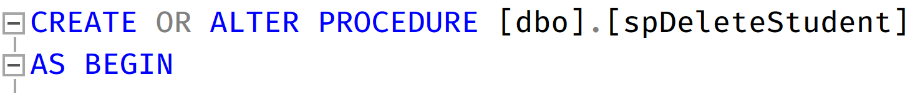
CREATE OR ALTER
Notes:
SQL 2016 and above

Slide 57
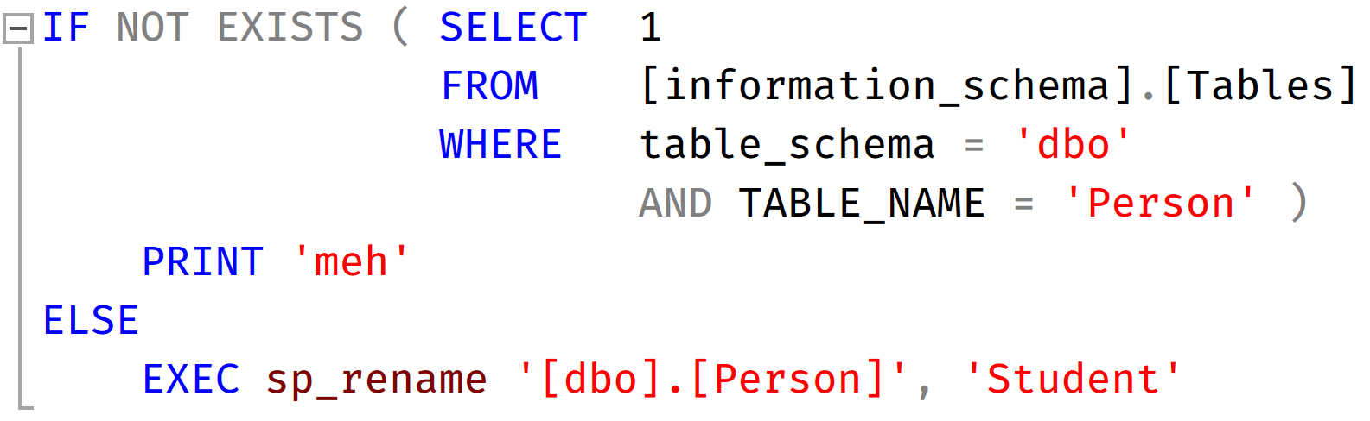
Renaming a table

Slide 58
Multi-stage migrations

Slide 59
Splitting a column
Create new columns
Migrate data
Rename if necessary
Delete if necessary
Bogard, Jimmy
Bogard
Jimmy

Slide 60
Splitting a table
Create new schema
Migrate data
Remove old columns
Id | Name | Alias1 | Alias2 | Alias3
1 | Jimmy | Jim | Jimbo | Jimster
Id | Name
1 | Jimmy
PersonId | Alias
1 | Jim
1 | Jimbo
1 | Jimster

Slide 61
Migrations at scale

Slide 62
Zero-downtime changes

Slide 63
More deliberate, incremental process
https://stripe.com/blog/online-migrations

Slide 64
Dual Writing
Application
Id | Name | Alias1 | Alias2 | Alias3
1 | Jimmy | Jim | Jimbo | Jimster
PersonId | Alias
1 | Jim
1 | Jimbo
1 | Jimster

Slide 65
Dual Writing
Application
Id | Name | Alias1 | Alias2 | Alias3
1 | Jimmy | Jim | Jimbo | Jimster
PersonId | Alias
1 | Jim
1 | Jimbo
1 | Jimster

Slide 66
What about existing data?
Write paths only take care of new data
Need to migrate existing data
Either all at once, or split into batches
Ensure you don’t overwrite data

Slide 67
Update Read Paths
Application
Id | Name | Alias1 | Alias2 | Alias3
1 | Jimmy | Jim | Jimbo | Jimster
PersonId | Alias
1 | Jim
1 | Jimbo
1 | Jimster

Slide 68
Update Write Paths
Application
Id | Name | Alias1 | Alias2 | Alias3
1 | Jimmy | Jim | Jimbo | Jimster
PersonId | Alias
1 | Jim
1 | Jimbo
1 | Jimster

Slide 69
Remove Old Data
Application
Id | Name | Alias1 | Alias2 | Alias3
1 | Jimmy | Jim | Jimbo | Jimster
PersonId | Alias
1 | Jim
1 | Jimbo
1 | Jimster

Slide 70
Data integrity checks at each step!

Slide 71
Large Table Migrations
Create new table w/ new schema
Batch fill new table
Rename old table to new
Id | Name | Alias1 | Alias2 | Alias3
1 | Jimmy | Jim | Jimbo | Jimster
… | … | … | … | …
1e8 | John | JJ | Johnny
Id | Name
1 | Jimmy
PersonId | Alias
1 | Jim
1 | Jimbo
1 | Jimster

Slide 72




What about NoSQL???

Slide 73
Schema exists… it’s in your code

Slide 74
Do we NEED to migrate?

Slide 75
Not unlike API/message versioning (and it’s still JSON)

Slide 76
Microservices?
Sales
Underwriting
Quote
Issuance
Admin

Slide 77
Right DB for the job
Sales
Underwriting
Quote
Issuance
Admin
SQL
DocDB
DocDB
DocDB
SQL

Slide 78
NoSQL Migration Options
Migrate on read
Migrate using tool
node-migrate
Or…don’t

Slide 79
Separate transactional from historical
Sales
Underwriting
Quote
Issuance
Admin
SQL
DocDB
DocDB
DocDB
SQL
Q
ETL
DW

Slide 80
Parting Thoughts
CI/CD with databases is not only possible, it’s necessary
It requires more thought and planning
Mistakes are more costly
Learn your DBAs whisky preference

Slide 81
Continuous Integration and Delivery for Databases
Jimmy Bogard
@jbogard
github.com/jbogard
jimmybogard.com
Chief Architect, Headspring

